Slide 2
1. Summary & Proposal
Summary
Collection model for Retail Unsecured and Credit card customer in bucket B03 (from 60 to 90 DPD) was built to predict the probability of moving to more than 90 DPD in next 2 months. The model is expected to be used to improve Collection performance in this bucket.
The model has Gini 62.5% and PSI 6.4% which indicate high predictive power and stability.
The classification of customer based on the model is showed in the table beside which helps to define Collection strategy.
Proposal
Retail risk to define Collection strategy based on model result.
Modeling to send list of customers with risk level to Collection on monthly basis.
Modeling to monitor model on monthly basis.
(*) The distribution is showed for development and in time validation sample.
Score distribution by score band*
Score Band | Total | Bad | Good | %Bad in band | %Bad in band and over
B01 | 725 | 718 | 7 | 99.0 | 89.5
B02 | 578 | 570 | 8 | 98.6 | 88.9
B03 | 1385 | 1356 | 29 | 97.9 | 88.4
B04 | 1246 | 1210 | 36 | 97.1 | 87.1
B05 | 1296 | 1256 | 40 | 96.9 | 85.7
B06 | 1852 | 1762 | 90 | 95.1 | 83.8
B07 | 1234 | 1149 | 85 | 93.1 | 80.1
B08 | 637 | 587 | 50 | 92.2 | 76.5
B09 | 647 | 568 | 79 | 87.8 | 73.9
B10 | 1266 | 1054 | 212 | 83.3 | 71.1
B11 | 644 | 480 | 164 | 74.5 | 63.0
B12 | 630 | 407 | 223 | 64.6 | 57.1
B13 | 638 | 317 | 321 | 49.7 | 49.7
GINI |  | PSI (Jul 2023)
Development sample | Out of time sample
62.5% | 60.1% | 6.4%

Slide 3
2. Development sample
Data creation
A sample of all retail unsecured and credit card customers who have delinquency from 60 to 90 on unsecured loan and credit card at the end of month from Feb 2023 to Apr 2023 was taken for develop Collection model for Retail unsecured and credit card customers in B03.
Observation date: end of month from Feb to Apr 2023.
Outcome period: 2 months after observation date.
Good and Bad definitions were defined according to the following table.
Sample illustration
Initial Sample
All retail customers who have unsecured loan and credit card in B03 at end of month from Feb 2023 to Apr 2023 | 20 282
Remove bad bank, restructured customers, Roll back T-1*
After the removal | 18 252
Definition | Frequency | Percent
Bad: Move to higher bucket (Greater than B03) at the end of each month in outcome period | 16 333 | 89.5%
Good: Other | 1 919 | 10.5%
Total | 18 252 | 100%
Development sample (70%)
Total | Good | Bad | Bad rate
12 778 | 1 344 | 11 434 | 89.5%
Validation sample (30%)
Total | Good | Bad | Bad rate
5 474 | 575 | 4 899 | 89.5%
(*) Roll back T-1 are customers in B03 as of observation date but were in higher bucket at end of previous months.
Outcome period (2 months)
Outcome period (2 months)
Outcome period (2 months)
2023
Feb
Mar
Apr
May
Jun
Jul
Aug
Sep
Oct
Development Sample
Out-of-time Sample

Slide 4
3. Variables
3.1. Source of information
No. | Group | Descriptions | Variable | Prediction | Variables in model
1 | Loan | Historical delinquency Loan information, variation in balance, etc. | 210 | Medium | 2
2 | Collateral & Deposit | Number of collateral Total deposit amount | 35 | Weak | 0
3 | Current account | Number of spend count Payment count (in and out) | 44 | Weak | 0
4 | Credit card | Historical delinquency Credit card transaction Credit card transaction, utilization, etc. | 169 | Medium | 2
5 | Historical Application | Historical application Demographic information | 69 | Weak | 1
6 | Collection | Number of action, % of action type Response of customer, etc Indicator from Retail Risk | 119 | Medium | 1
7 | Credit bureau | PCB information CIC information | 93 | Weak | 0
8 | Loan + Credit card | Historical delinquency Loan and credit card information, variation in balance, etc | 110 | Strong | 3
9 | Others | Cross variables | 4 | Strong | 0
 | Total | 853 variables were analyzed |  |  | 9

Slide 5
3. Variables
3.2. Variable explanation
No. | Variable name | Description | IV
1 | N_DPD_EOM_CHANGE_M3 | Comparison customer's bucket at end of months T-3 with T-2, T-2 with T-1, and T-1 with T (T: observation date): Low: if bucket at end of T-3 >= bucket at end of T-2, similar for the couples (T-2, T-1), (T-1, T), Up: if bucket at end of T-3 < bucket at end of T-2, similar for the couples (T-2, T-1), (T-1, T). | 1.07
2 | CHECK_REDUCE_DPD_C12 | The number of months that customer reduced overdue during last 12 months before the observation date (only compare the DPD among end of months). | 0.84
3 | N_LOWDPD_ALL_C12 | Number of times the customer had decreased overdue in last 12 months before observation date (Loan and Credit card) | 0.78
4 | CC_INCREASE_BAL_C1 | The difference between total balance of customer’s credit card at observation date and total balance of customer’s credit card at 1 month before observation date | 0.57
5 | PAYMENT_3M | Total customer’s repayment amount for credit card during 3 months before observation date | 0.47
6 | REPAY_AMT_C3 | Total amount paid to repay for loans during last 3 months before observation date | 0.43
7 | REDUCE_RATE_EAD_C2 | The decrease of total balance of customer's loans in last 2 months divided by balance of all customer's loans at 2 months prior to the observation date | 0.38
8 | PCT_PROMISE_1M | The ratio between variable Number of times customer promised to pay during last month before observation date and number of actions (includes call, fields) during last month before observation date | 0.33
9 | COOPERATIONVPB_TIME | Time with VPBank (Months) | 0.3

Slide 6
3. Variables
3.3. Variable explanation
N_DPD_EOM_CHANGE_M3
Group | Details | Bad rate | IV
[01] | 01. LOW,LOW,LOW | 47.3 | 1.07
[02] | 02. UP,LOW,LOW | 65.8
[03] | 03. LOW,UP,LOW | 67.7
[04] | 04. LOW,LOW,UP | 75.1
[05] | 05. UP,UP,LOW | 78.8
[06] | 06. UP,LOW,UP | 85.8
[07] | 07. LOW,UP,UP | 89.4
[08] | 08. UP,UP,UP | 95.9
CHECK_REDUCE_DPD_C12
Group | Details | Bad rate | IV
[01] | 0 | 95.2 | 0.84
[02] | 1 | 87.4
[03] | 2 | 77.0
[04] | 3 | 66.5
[05] | (3; High) | 55.9
N_LOWDPD_ALL_C12
Group | Details | Bad rate | IV
[01] | 0 | 97.2 | 0.78
[02] | 1 | 95.5
[03] | 2 | 94.2
[04] | (2; 4] | 91.5
[05] | (4; 6] | 87.6
[06] | 7 | 84.6
[07] | 8 | 81.2
[08] | (8; 10] | 77.0
[09] | (10; High) | 68.3
CC_INCREASE_BAL_C1 (Mil. VND)
Group | Details | Bad rate | IV
[01] | No credit card | 89.7 | 0.57
[02] | (Low; 0) | 64.2
[03] | [0; 0.2] | 81.7
[04] | (0.2; 0.5] | 88.9
[05] | (0.5; 2.5] | 93.7
[06] | (2.5; High) | 94.9

Slide 7
3. Variables
3.3. Variable explanation
PAYMENT_3M (Mil. VND)
Group | Details | Bad rate | IV
[01] | No credit card | 89.7 | 0.47
[02] | (Low; 0.15] | 95.0
[03] | (0.15; 0.5] | 93.2
[04] | (0.5; 1.5] | 88.7
[05] | (1.5; 2] | 86.0
[06] | (2; High) | 77.5
REPAY_AMT_C3 (Mil. VND)
Group | Details | Bad rate | IV
[01] | No Loan/ No payment | 91.3 | 0.43
[02] | (Low; 0.3] | 96.9
[03] | (0.3; 2] | 92.1
[04] | (2; 8] | 83.1
[05] | (8; 14] | 71.8
[06] | (14; High) | 60.3
REDUCE_RATE_EAD_C2 (%)
Group | Details | Bad rate | IV
[01] | New overdraft or Increase balance | 93.1 | 0.38
[02] | No loan | 90.7
[03] | (-0.5; 3.5] | 74.0
[04] | (3.5; High) | 63.2
COOPERATIONVPB_TIME (months)
Group | Details | Bad rate | IV
[01] | (Low; 4] | 98.7 | 0.3
[02] | (4; 5] | 98.2
[03] | (5; 9] | 95.1
[04] | (9; 20] | 91.2
[05] | (20; 35] | 88.5
[06] | (35; 100] | 86.6
[07] | (100; High) | 81.0
PCT_PROMISE_1M
Group | Details | Bad rate | IV
[01] | (Low; 0] | 92.6 | 0.33
[02] | (0; 0.1] | 85.8
[03] | (0.1; 0.3] | 82.8
[04] | (0.3; 0.5] | 78.0
[05] | (0.5; High) or No call and no field visit | 66.3

Slide 8
4. Model performance
Score Band | Total | Bad | Good | %Bad in band | %Bad in band and over
B01 | 724 | 717 | 7 | 99.0 | 89.5
B02 | 576 | 567 | 9 | 98.4 | 88.9
B03 | 1280 | 1254 | 26 | 98.0 | 88.4
B04 | 1359 | 1321 | 38 | 97.2 | 87.2
B05 | 1293 | 1253 | 40 | 96.9 | 85.7
B06 | 1852 | 1758 | 94 | 94.9 | 83.8
B07 | 1227 | 1146 | 81 | 93.4 | 80.2
B08 | 645 | 593 | 52 | 91.9 | 76.5
B09 | 656 | 576 | 80 | 87.8 | 73.9
B10 | 1252 | 1042 | 210 | 83.2 | 71.0
B11 | 643 | 482 | 161 | 75.0 | 63.1
B12 | 642 | 411 | 231 | 64.0 | 57.0
B13 | 629 | 314 | 315 | 49.9 | 49.9
Sample | Gini
Development sample (70%) | 62.5%
Validate sample (30%) | 61.2%
Out of time sample (May & Jun 2023) | 60.1%
Comment:
The model has high predictive power.
Gini on out of time sample is close to Gini on development sample which show the stable predictive power of the model.

Slide 9
5. Model stability
5.1. Characteristic Stability

Slide 10
5. Model stability
5.2. Population stability
Development sample: Feb – Apr 2023
Recent sample: Jul 2023
Comment:
The PSI of the model is low (about 6% in recent sample) showing that the model is stable.
The model need to be strictly monitored.

Slide 11
Appendix

Slide 12
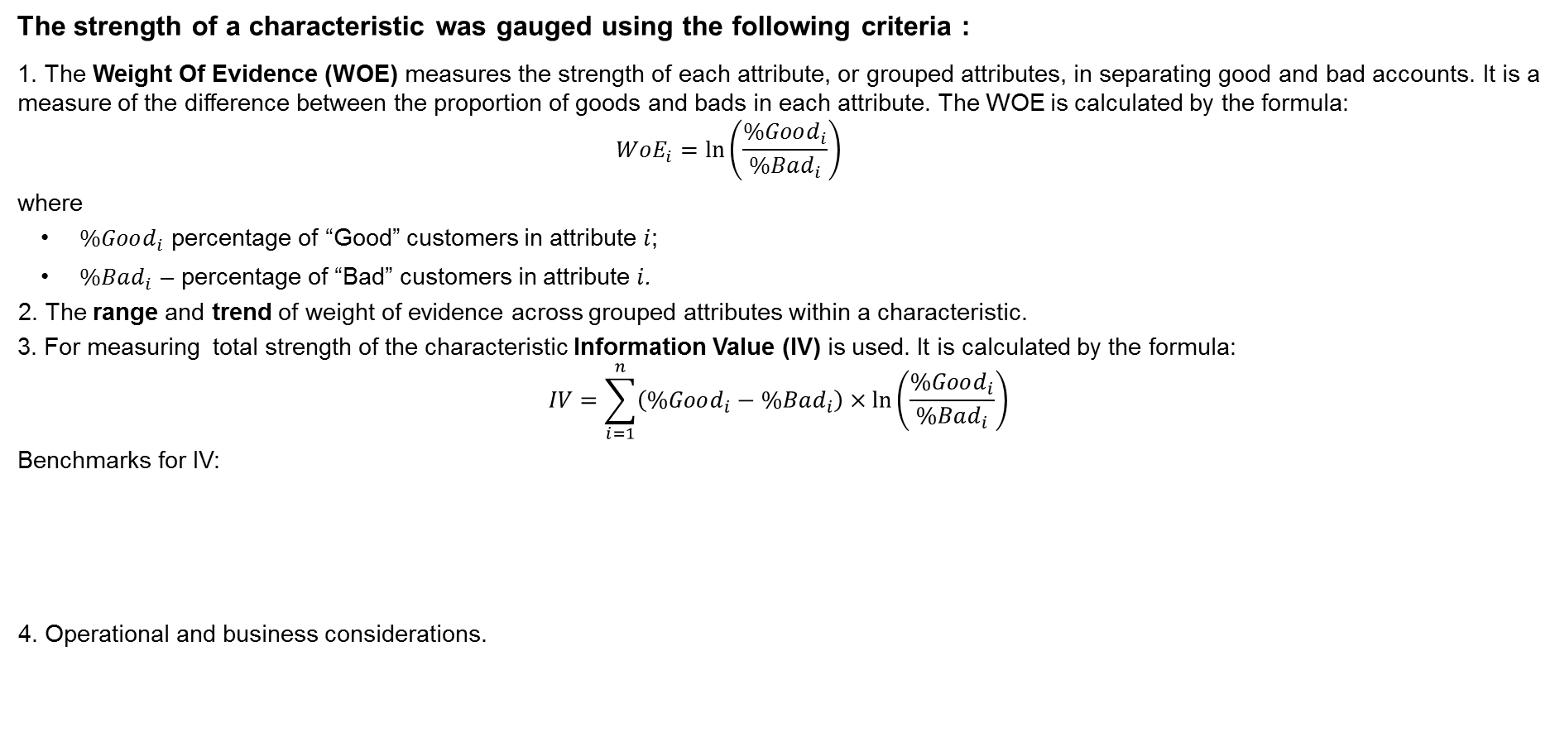
Characteristic Analysis
The strength of a characteristic was gauged using the following criteria :
1. The Weight Of Evidence (WOE) measures the strength of each attribute, or grouped attributes, in separating good and bad accounts. It is a measure of the difference between the proportion of goods and bads in each attribute. The WOE is calculated by the formula:
$$WoE_{i}=\ln\left(\frac{\%Good_{i}}{\%Bad_{i}}\right)$$
where
$\%Good_{i}$ percentage of “Good” customers in attribute $i$;
$\%Bad_{i}$ – percentage of “Bad” customers in attribute $i$.
2. The range and trend of weight of evidence across grouped attributes within a characteristic.
3. For measuring total strength of the characteristic Information Value (IV) is used. It is calculated by the formula:
$$IV=\sum_{i=1}^{n}{\left(\%Good_{i}−\%Bad_{i}\right)}×\ln\left(\frac{\%Good_{i}}{\%Bad_{i}}\right)$$
Benchmarks for IV:
4. Operational and business considerations.
IV
0.02
0.1
0.3
Un-predictive
Weak
Medium
Strong

Slide 13
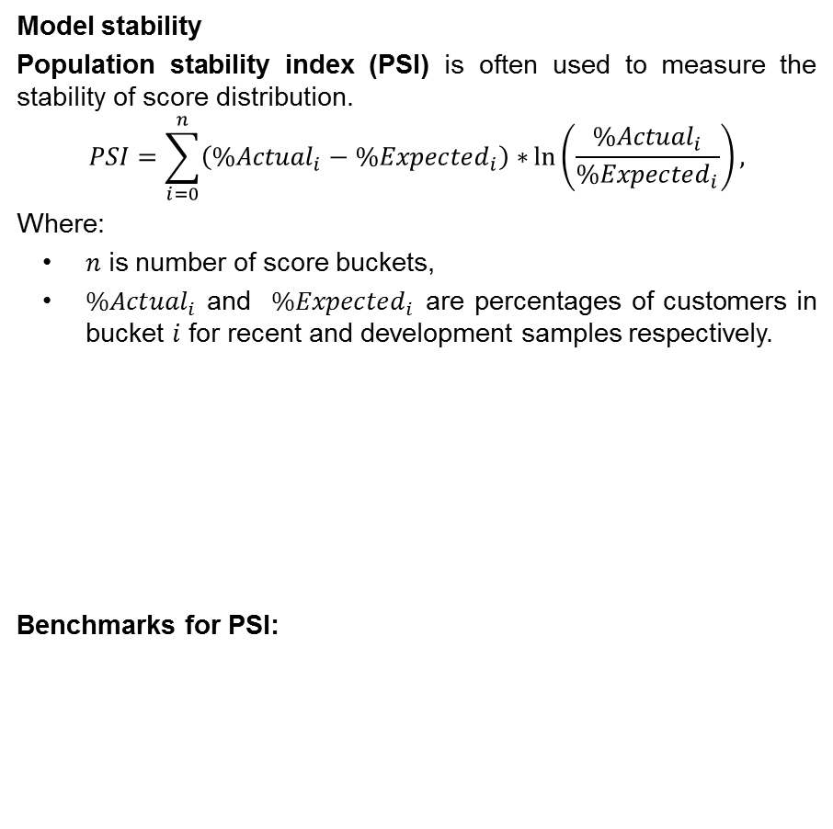
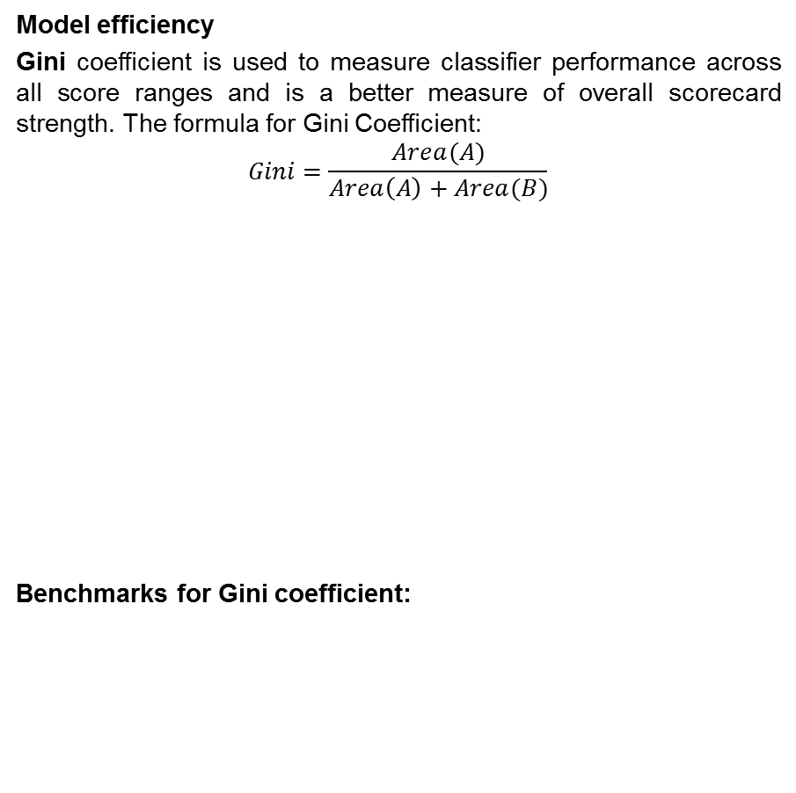
Efficiency and stability parameters
Model efficiency
Gini coefficient is used to measure classifier performance across all score ranges and is a better measure of overall scorecard strength. The formula for Gini Coefficient:
$$Gini=\frac{Area(A)}{Area\left(A\right)+Area(B)}$$
Benchmarks for Gini coefficient:
Model stability
Population stability index (PSI) is often used to measure the stability of score distribution.
$$PSI=\sum_{i=0}^{n}{\left({\%Actual}_{i}−{\%Expected}_{i}\right)∗}ln\left(\frac{{\%Actual}_{i}}{{\%Expected}_{i}}\right),$$
Where:
$n$ is number of score buckets,
${\%Actual}_{i}$ and ${\%Expected}_{i}$ are percentages of customers in bucket $i$ for recent and development samples respectively.
Benchmarks for PSI:
B
A
50%
60%
10%
20%
Weak
Medium
Strong
No meaningful change
Small change
Significant change

Slide 14
Thank you!

